Slide 1
Automating Contact Tracing through Whatsapp in Lebanon
Fahad Beyari, Victoria Haver, Ann Hoang, Randy Maysaud, Jenny Tran
(Team 83)

Slide 2

The Problem
Medical supplies and resources are concentrated in big cities.
There is no database compiling village-level data on COVID-19 spread.
NGOs and governmental organizations are working in the dark.

Slide 3
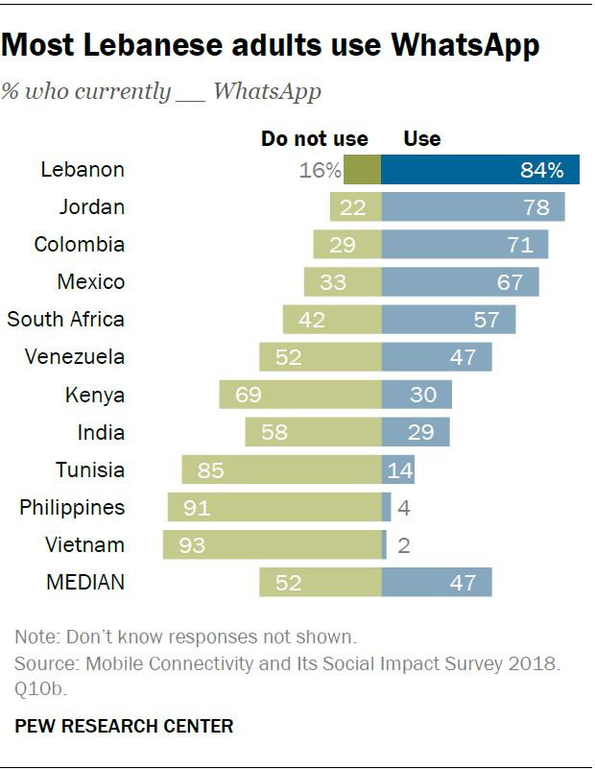
Our Solution
Identify potentially positive cases
Collect location data for home village and other recent destinations
Collect vulnerability data: access to clean water, age, and underlying health conditions
Compile data spatially and visualize villages with high need
Distribute live map to key actors, such as the Lebanese Red Cross

Slide 4
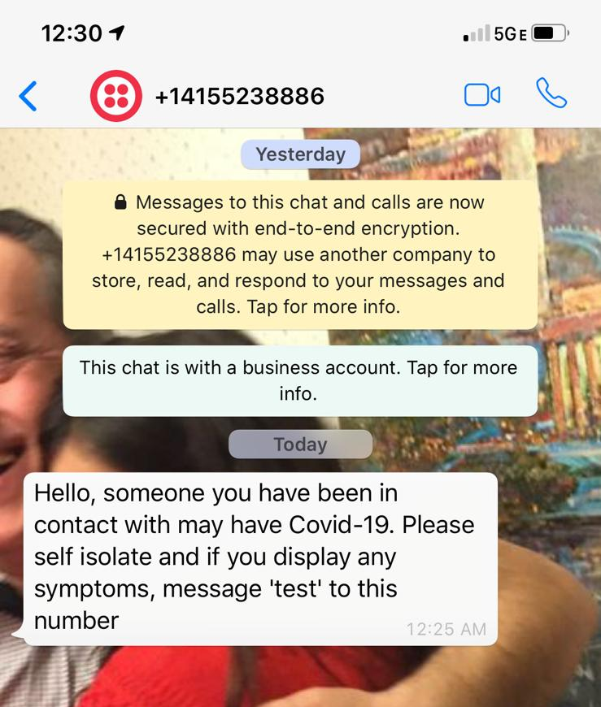
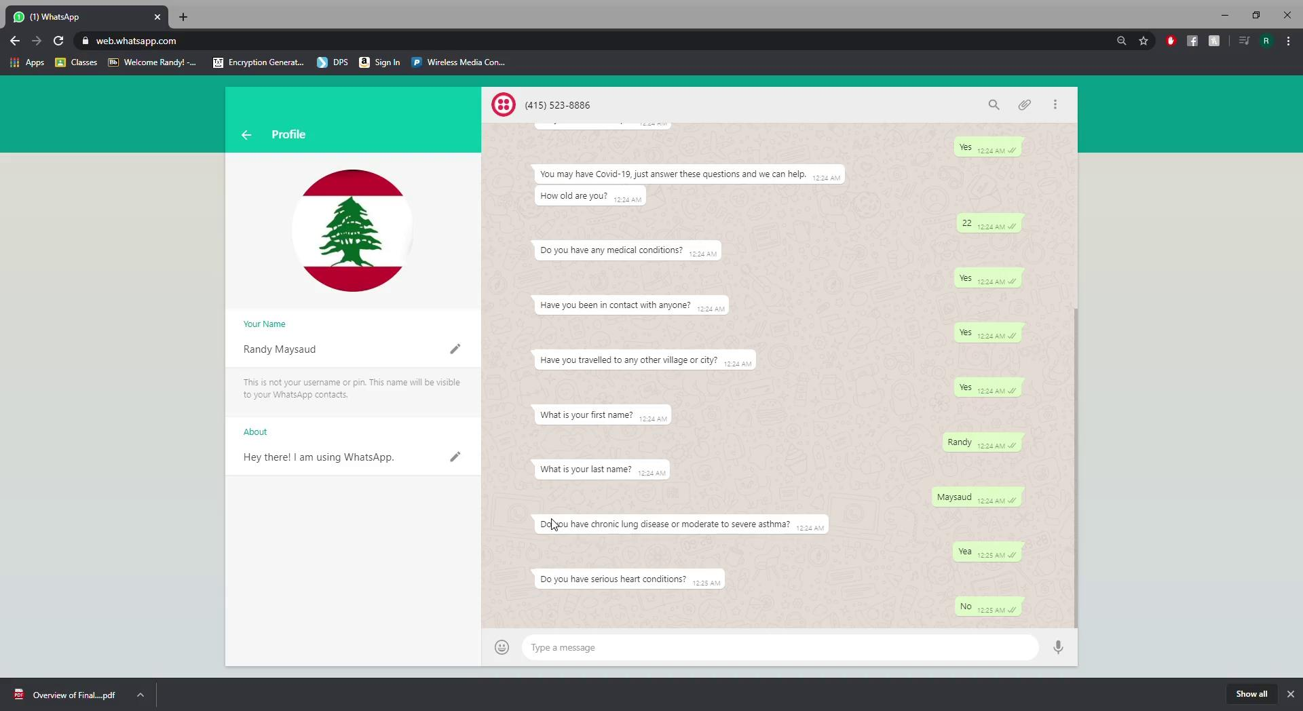
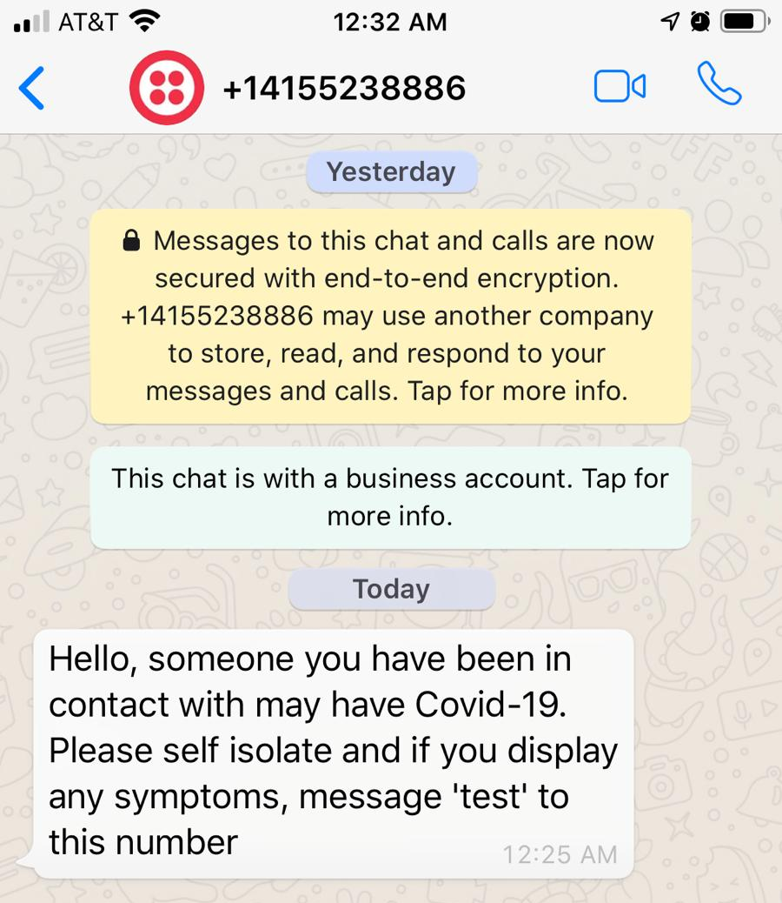
Phase I - Collect Data

Slide 5
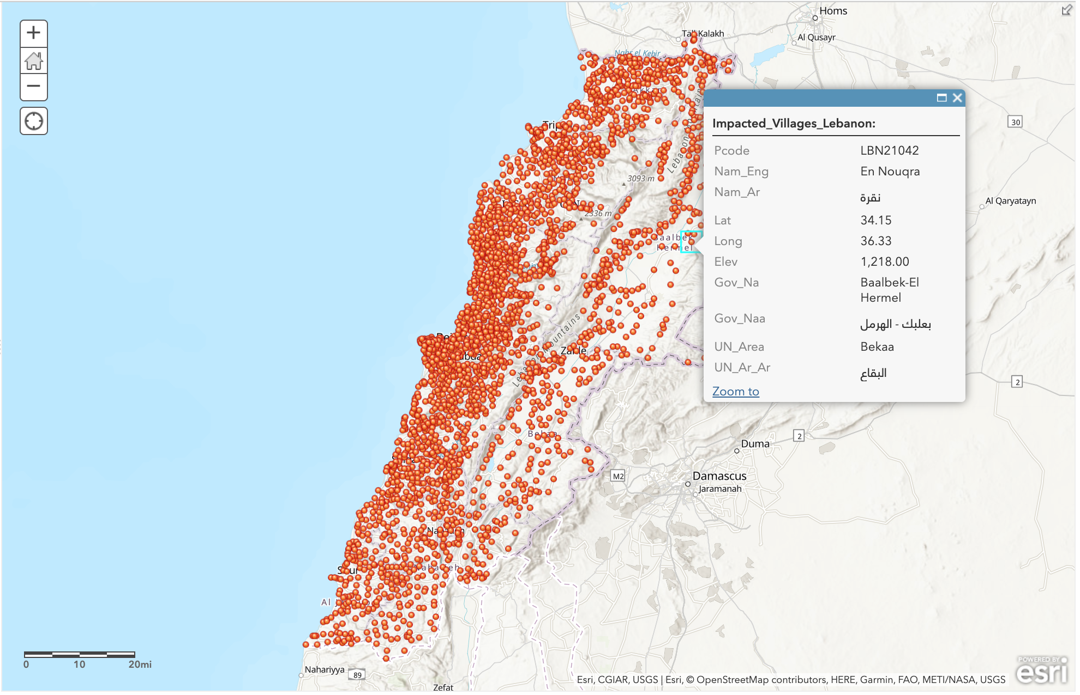
Phase II - Live Map
Join tabular level data to existing feature layer using a rest service through ArcGIS and Esri.
Symbolize villages on two levels: those with existing cases and those which have been visited by existing cases. Use shading to depict villages with higher vulnerability.

Slide 6
Phase III - Scalability
If successful, consider implementation in other countries.
Use SMS-messaging if necessary.
Leverage new contacts to promote methodological use.
Open-source data can be used by other groups working in the field.
Use data in post-pandemic environment to trace network of disease spread.

Slide 7
Timeline
Reach out to contacts in Lebanon
Begin working on ArcGIS API
Continue working on Whatsapp Bot
Begin Whatsapp messaging throughout Lebanon
Ensure smooth transition of data to map
Continue contacting NGOs
April 10th
April 27th
April 3rd
April 24th
Complete ArcGIS API and Whatsapp Bot
Join SQL database to live map layer
Establish contact network and create rollout plan for program
Disseminate map to key players and organizations
Continue to troubleshoot and monitor data collection methods and mapping system

Slide 8
Budget
Line-Item | Cost
Rented Server to Host Whatsapp API | $450 (for 3 months)
Phone with Whatsapp Capability | $25
Sim Card with Unlimited Texting | $20 (for 3 months)
Total: $495 for 3 months

Slide 9

Considering Ethics
Consult with contacts in Lebanon concerning relevant guidelines
Opt-in program
Secure server with hash-values
Follow Hipaa guidelines for COVID-19 concerning public release of information

Slide 10
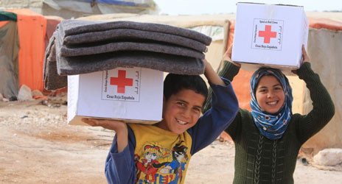
Expected Outcomes
Provide a relatively inexpensive method for tracking infection spread in Lebanese villages
Obtain more comprehensive demographic data for positive cases
Identify exact critical areas for distribution of aid, supplies, and testing kits
Identify high concentration of high-risk population and of positive COVID-19 cases
Distribute comprehensive statistics to NGOs (Red Cross), Lebanese government, and citizens to facilitate informative national health decisions

Slide 11



Special Thanks to
Professor Tyler Davis
Adam Goodwin
Professor Leah Shaw

Slide 12
“We don’t have the luxury of learning by doing here. We only have time to do, and [to] do what is right.”
Professor Fadi El-Jardali

